Slide 1
Lesson 1: Sequencing
Year 7 – Programming essentials in Scratch: part I
Notes:
Last updated:10/08/2021
This resource is licensed under the Open Government Licence, version 3. For more information on this licence, see ncce.io/ogl.

Slide 2
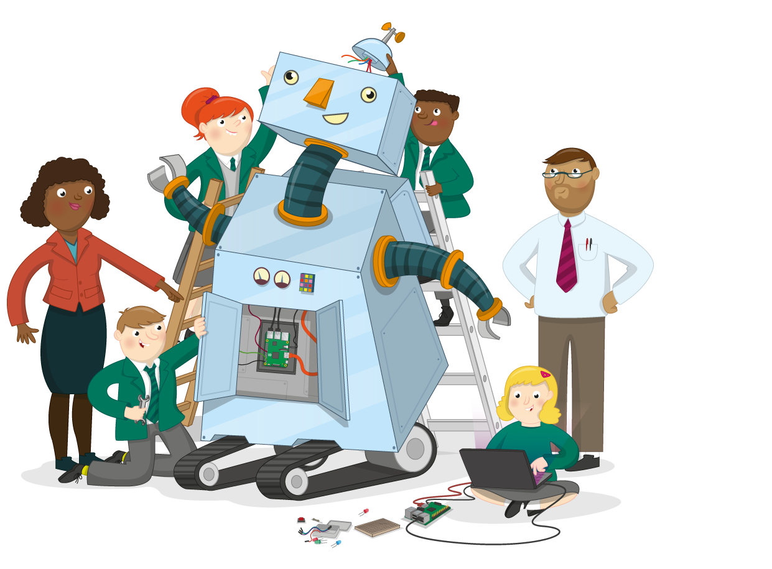
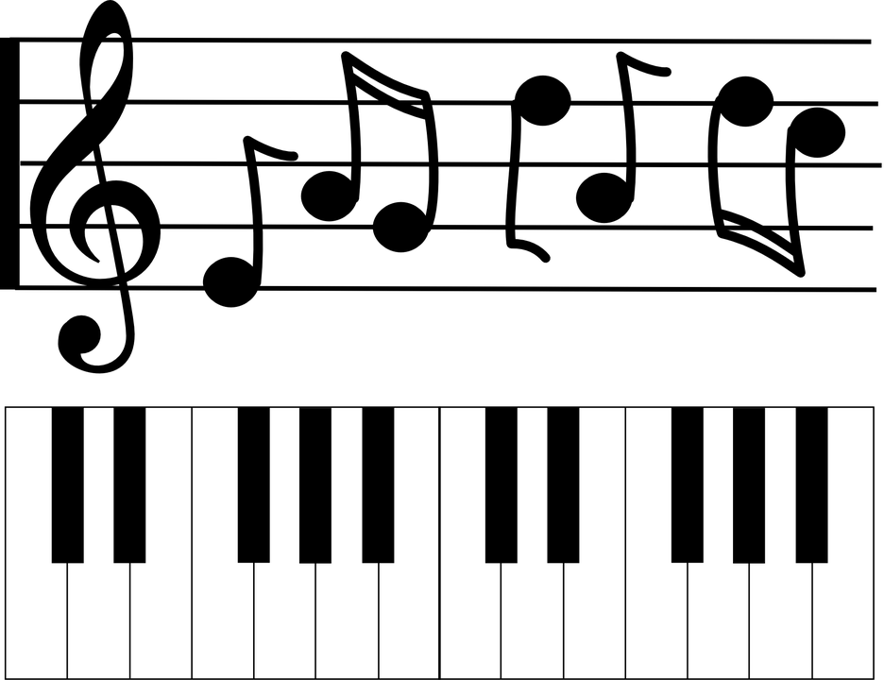
Robots vs humans
Starter activity
Question: Can a computer do the job of a musician?
Think, pair, share
Notes:
Music score image source: https://pixabay.com/vectors/keyboard-piano-notes-treble-clef-310740/

Slide 3

Lesson 1: Sequencing
Objectives
In this lesson, you will:
Compare how humans and computers understand instructions
Define a sequence
Predict the outcome of a simple sequence
Modify a sequence

Slide 4
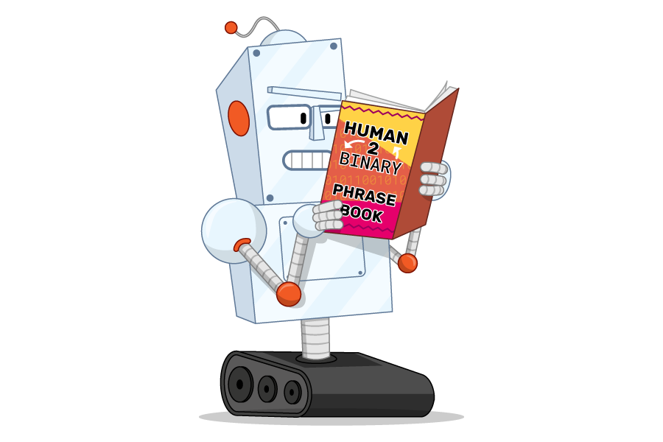
The robot and the computer programmer
Activity 1
Volunteer needed
Volunteer 1 will play the role of a human-like robot that can move
The rest of the class will take it in turns to play a computer programmer and will give instructions to the robot

Slide 5
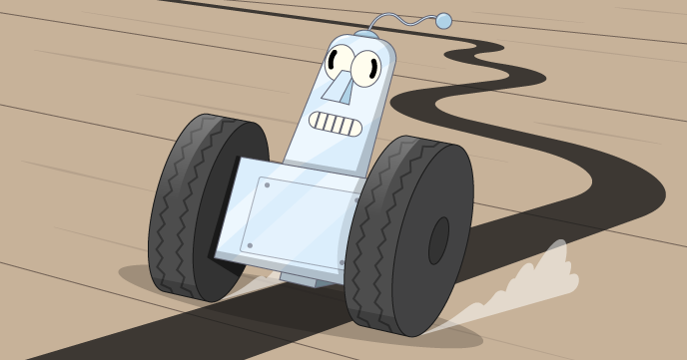
Task 1
Activity 1
The computer programmer will now give the robot a series of commands
Notes:
If possible, draw a floor plan of the classroom on a whiteboard and show the path you want the robot to complete (ideally the robot shouldn’t be able to see this). Ask the programmer to give commands to the robot to complete this circuit. Alternatively you could draw this on a sheet of paper and give it to the computer programmer.

Slide 6
Task 1: reflection (think/write/pair/share)
Activity 1
Did the robot successfully complete the path around the room?
Was there any confusion?
Why do you think this was?
Notes:
Allow the learners to spend a small amount of time reflecting on what was successful and what went wrong (if anything). If it didn’t go wrong, why was that?
During group discussion, encourage the learners to think about the commands used. Did the robot make any assumptions? For example, when turning, were the directions and angle specified? Did the robot follow every command precisely and not assume anything. Did the programmer need to give better/more specific commands?

Slide 7

Computers execute commands
Activity 1
When you create a program for a computer, you give it a set of commands to execute
It will execute these commands precisely
Watch this video
Notes:
When you create a program for a computer, you give it a set of commands to execute. It will follow to these commands to the letter

Slide 8
Task 2
Activity 1
The robot will now be instructed to complete a different path around the classroom
This time the computer can only use the following commands:
Forward (number of footsteps)
Right (degrees)
Left (degrees)
Notes:
For this activity, decide upon a new route, but this time the route should include going through (a closed) classroom door. There is no instruction to open the door. In theory the learner playing the role of the robot should not attempt to open the door (allow them to if they naturally decide to open the door)

Slide 9
Task 2: Reflection
Activity 1
Did the robot go through the door?
Should they have gone through the door?
What was needed to allow them to go through the door?
Notes:
The aim of this class discussion is for the learners to understand that computers need precise commands to be able to go through

Slide 10
Computer programming
Activity 2

Slide 11

“Programming is how you get computers to solve problems”
Activity 2
There are two key phases that are important here:
You: Without the programmer (you), the computer is useless. It does what you tell it to do.
Solve problems: Computers are tools. They are complex tools, admittedly, but they are not mysterious or magical: they exist to automate tasks.

Slide 12
Three key concepts
Activity 2
Over the next set of lessons you will look at the three key programming concepts:
Sequence: Running instructions in order
Selection: Making choices
Iteration: Doing the same thing more than once

Slide 13
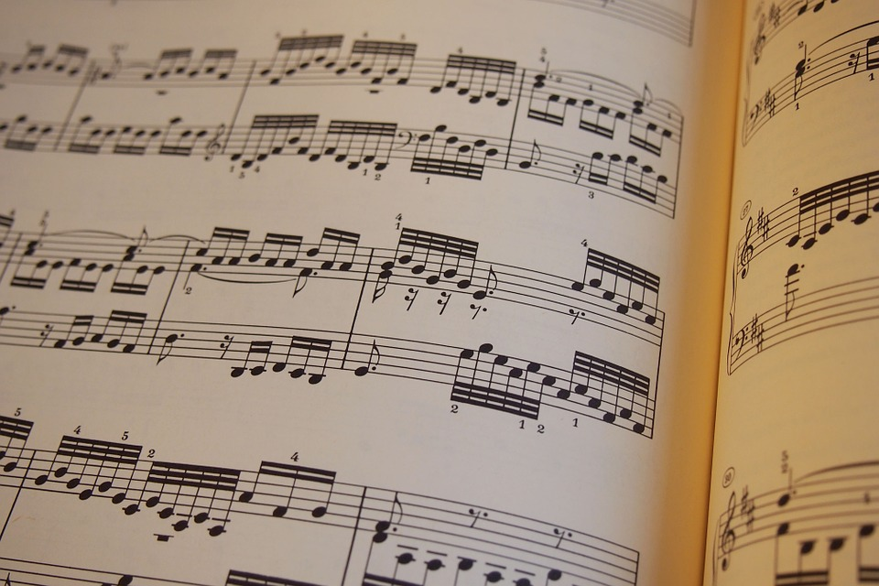


Sequencing: Instructions performed in order, with each executed in turn
Activity 3
As you have seen, computers will follow your instructions precisely and in the order in which you tell it.
Can you think of any non-computing related examples of where instructions need to be carried out in the correct sequence?
Notes:
Define the term sequencing to the learners. Ask them to think about where they might have seen sequencing before that isn’t related to computers. Three examples on the images: music scores, cooking recipes, furniture and lego assembly instructions
Sheet music image source: https://pixabay.com/photos/music-sheet-music-piano-sheet-music-656593/
Furniture assembly image source: https://commons.wikimedia.org/wiki/File:Carpenters_with_furniture_assembly_instructions.jpg
Recipes image source:https://pixabay.com/vectors/book-cook-eat-food-kitchen-recipe-1292854/

Slide 14
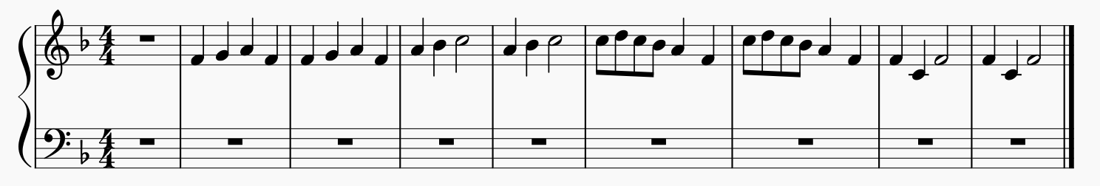
Music sequence
Activity 3
Could a computer play music in a sequence?
What extra information would it need to play this music sequence?
Notes:
A computer that was able to output sound would be able to play this sequence, as long as was programmed to:
1. Know what sound each note made
2. Know how long to play each note for

Slide 15
The sequence
Activity 3
Frère Jacques,
Frère Jacques,
Dormez-vous?
Dormez-vous?
Sonnez les matines!
Sonnez les matines!
Ding, dang, dong,
Ding, dang, dong,

Slide 16

Pair programming
Activity 4
For the next activity you will be placed into pairs to complete the work
You will take turns to be the driver and the navigator
The driver: Your role is to control the keyboard and mouse and place the code block into the correct places
The navigator: Your role is to support the driver by watching for any mistakes, reading the instructions to the driver, or seeking support if needed

Slide 17
Sequence Frère Jacques: Your turn
Activity 4
Open the following Scratch program:
ncce.io/Y7sequencing1
Work in pairs and follow the task sheet to make the program play the song Frère Jacques.

Slide 18
Sequence Frère Jacques: Your turn
Activity 4

Slide 19

Plenary: Sequence the sounds
Plenary
For this exercise, we need nine volunteers:
Eight performers
One conductor
Notes:
Image source: https://pixabay.com/vectors/explosion-detonation-blast-burst-147909/

Slide 20
Next lesson
Summary
In this lesson, you…
Compared how humans and computers understand instructions
Defined a sequence
Modified a sequence
Next lesson, you will…
Learn about variables and be able to use them within a sequence

